Slide 1
Singleton
ChocolateBoiler
Boolean empty Boolean boiled ChocolateBoiler uniqueInstance
+ fill() : void + boil() : void + drain() : void + getInstance : void
Unique instance
getInstance

Slide 2
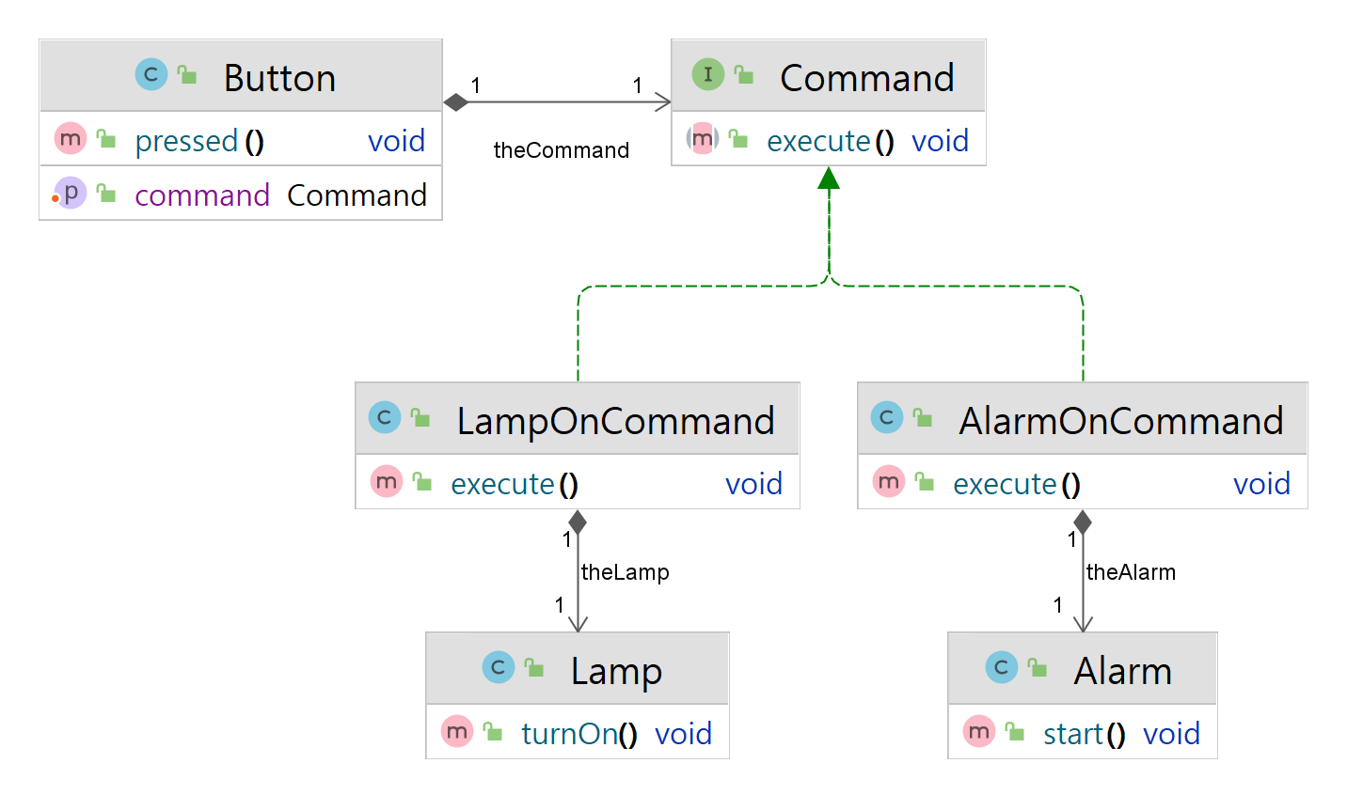
Invoker
Command
Concrete Command
Receiver

